Slide 1
Friends and family
32 Relative pronouns

Slide 2
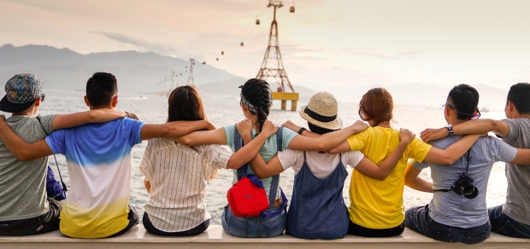
Your friends and family
Who are your friends?
When did you meet them?
Who are the members of your family?
How often do you spend time with them?
Friend, bestie, buddy, mate.
Friendly, people person.
Befriend, make someone your friend.
Frenemy, (inf.) a rival whom you keep friendly relations.

Slide 3
Relative clauses
A relative clause gives information about a noun. It immediately follows the noun it describes and often begins with a relative pronoun (who, whom, whose, which, that...) They put two sentences together.
Example:
My best friend is a veterinarian.
My best friend has a saltwater aquarium.
My best friend who has a saltwater aquarium is a veterinarian.

Slide 4
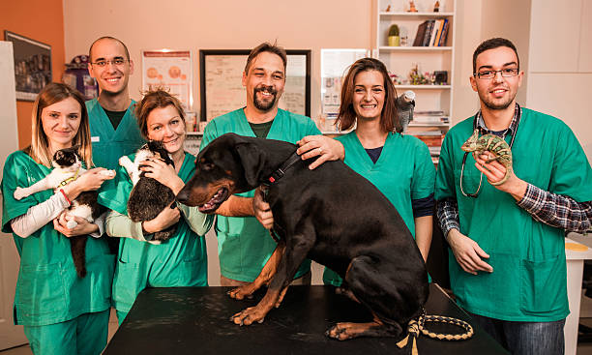
Defining and non-defining
A defining relative clause identifies the noun it refers to.
My best friend who holds the iguana is a veterinarian.
A non-defining relative clause gives additional information about something that is already clearly identified. Non-defining relative clauses are separated by commas from the rest of the sentence.
My best friend, who loves reptiles, is a veterinarian.

Slide 5
RELATIVE PRONOUN | USE | EXAMPLES
Who | For people | The children who live here are friendly. (defining) Pat, who lives next door, is a nurse. (non-defining)
Which | For things and animals | The play which we saw was excellent. (defining) This apartment, which is in the center of the city, is suitable for us. (non-defining)
That | can replace who or which in defining relative clauses only. a. often used after words like all, none, little, few, anything, nothing b. after superlatives (often with the Present Perfect) | Here’s the child that sang so well. Did you buy the shoes that you wanted? There is little that we can do. That was the best movie that I have ever seen!

Slide 6
Put these sentences together
My cousin is coming to visit us next week. | My cousin lives in the city. | My cousin who lives in the city is coming to visit us next week.
The book was an inspiring read. | My mom recommended the book.
My friend is reliable. | My friend helped me move.
The cake was delicious. | My sister made the cake.
The neighbors hosted a barbacue. | The neighbors live next door.
The dog is always cheerful. | The dog lives in the blue house.
The laptop is new. | I am using the laptop.
My aunt is very patient. | My aunt taught me how to knit.
The car is incredibly fuel-efficient. | I just bought the car.
Notes:
The book that/which my mom recommended was an inspiring read.
My friend who helped me moved is reliable.
The cake that/which my sister made was delicious.
The neighbors who live next door hosted a BBQ.
The dog that/which lives in the blue house is always cheerful.
The laptop that/which I am using is new.
My aunt who taught me how to knit is very patient.
The car that/which I just bought these incredibly fuel efficient.

Slide 7
RELATIVE PRONOUN | USE | EXAMPLES
Whom | for people – used in formal English a. as the object b. after prepositions | This is the teacher whom I described. (defining) The Bartons, to whom we have just spoken, are coming to visit us soon. (non-defining)
How can you tell when your pronoun is the object of a verb or preposition? Try substituting “he” or “she” and “him” or “her.” If “he” or “she” fits, you should use who. If “him” or “her” fits, you should use whom. This is the teacher. I described the teacher. I described her. ✓ The Bartons are coming to visit us soon. We have just spoken to the Bartons. We have just spoken to them. ✓ She is my aunt. She taught me how to knit. Her taught me how to knit. ✗
Whose | to show possession | The man whose car was damaged is upset. (defining) Tim Smith, whose house is on my street, works at the local school. (non-defining)
Notes:
How can you tell when your pronoun is the object of a verb or preposition? Try substituting “he” or “she” and “him” or “her.” If “he” or “she” fits, you should use who. If “him” or “her” fits, you should use whom. Keep in mind that you may have to temporarily rearrange the sentence a bit while you test it.
This is the teacher. I described her.
She is the candidate. I voted for her.
The Bartons are coming to visit us soon. We have just spoken to them.
Extra exercise
https://www.youtube.com/watch?v=pjwqYHPTJhY

Slide 8
Put these sentences together
My friend is a great musician. | I met my friend at school | My friend whom I met at school is a great musician.
My best friend is sad. | His cat is missing.
The teacher is strict. | His class is very interesting.
The family was very hospitable. | We spent the weekend with them.
My doctor is very knowledgeable. | I consulted her for posture advice.
The couple looked really happy. | We attended to their wedding.
Our neighbors are moving away. | We have known them for years.
My colleague is presenting a new project. | My colleague’s ideas are great.
The team was highly skilled. | I collaborated with them.
Notes:
My best friend whose cat is missing is very sad.
The teacher whose classes are interesting is strict.
The family whom we spent the weekend with was very hospitable.
My doctor whom I consulted for posture advice is very knowledgeable.
The couple whose wedding we attended looked really happy.
Our neighbors whom we've known for years are moving away.
My colleague whose ideas are great is presenting a new project.
The team whom I collaborated with was highly skilled.

Slide 9
RELATIVE PRONOUN | USE | EXAMPLES
Where | for places | The house where I grew up looks the same. (defining) Here is City Bank, where I work. (non-defining)
When | for time | I remember the day when (that) we first met. (defining) I met her in March, when I was taking a computer course. (non-defining)
Notes:
Extra exercise
https://www.youtube.com/watch?v=pjwqYHPTJhY

Slide 10
Put these sentences together
I am meeting my friends at the park. | We used to play in the park. | I am meeting my friends at the park where we used to play.
We are planning to have a family picnic at the beach. | We can relax and enjoy at the beach.
We have the best time in game night. | We always get together in game night.
My cousins and I would go on road trips. | We were teenagers.
The cafeteria is beautiful. | We buy bread in the cafeteria.
I love the days. | My friends surprise me with their visits.
Our family loves visiting Magical Towns. | We can enjoy nature in Magical Towns.
The day was truly special. | We celebrated my grandma’s birthday.
The hiking trail is long. | We have a lovely time in the hiking trail.
Notes:
We are planning to have a family picnic at the beach where we can relax and enjoy.
We have the best time in game night when we always get together.
My cousins and I would go on road trips when we were teenagers. The cafeteria where we buy breadth is beautiful. I love the days when my friends surprise me with their visits. Our family loves visiting magical towns where we can enjoy nature. the day when we celebrated my grandma's birthday was truly special period the hiking trail when where we have a lovely time is long .

Slide 11
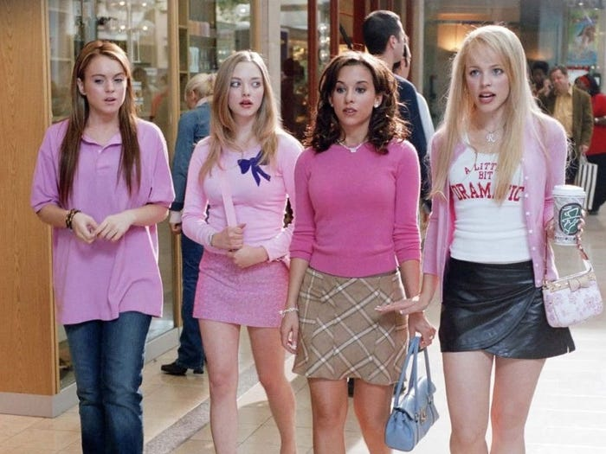
Show and tell
Tell your classmates about your best friend or a member of your family.
Regina George is a flawless girl who has 2 Fendi purses.
Her hair, which is blonde, is insured for $10,000.

